Slide 1

Daily Review
CFU 1
What is the medium that the sound is travelling through?
Identify compression and rarefaction in a sound wave
Identify the medium through which the sound is travelling. Are the particles within a medium bunched together? compression Are the particles within the medium spread out? rarefaction
You are scuba diving and you hear a boat start above you, does the arrow of the sound wave show compression or rarefaction?
CFU 2
Are the particles bunched together or spread out?
The sound wave is travelling through _____. The particles _____, therefore the arrow shows an area of _______.
Reminders:
Medium: a substance through which a wave travels.

Slide 2
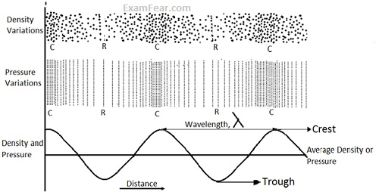
Daily Review
CFU 1
What effect does frequency have on the sound that is heard?
The frequency
High pitch/low pitch
Waves per second, measured in Hertz
The wave length
Distance between 2 crests or troughs
Distance travelled by one wave cycle
The amplitude
Distance a particle moves from its resting position
Distance from midline of a wave to the crest
Loud/soft
CFU 2
How could you measure the wavelength of a sound wave?
CFU 2
If a sound wave has a large amplitude, is it loud or soft?
Vocabulary
Crest: the maximum upward movement of a wave Trough: the maximum downward movement of a wave

Slide 3
Daily Review
Comparing Sound Waves
Compare the frequency/amplitude. Is one higher/lower? Are they equal? How does this affect the pitch/volume?
Compare and contrast the two sound waves below with reference to their pitch and loudness.
Sound wave A has a ________ frequency than sound wave B, therefore it will have a ______ pitch.
Sound wave A has a _________ amplitude than soundwave B, therefore it will be _______ than sound wave B.
Reminders:
Amplitude: the distance a particle moves from its resting point. Frequency: number of wave cycles per second

Slide 4
Speed of Sound Year 9 Physics

Slide 5
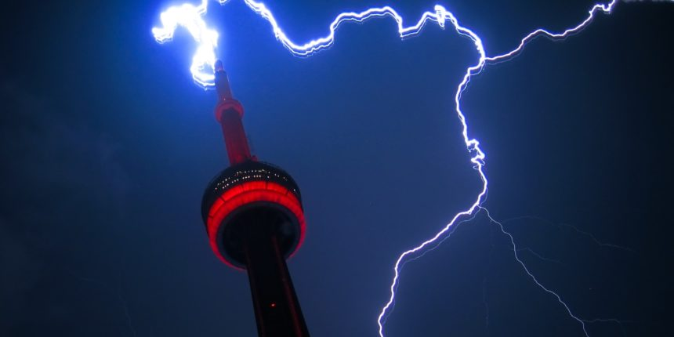
Learning Objectives
CFU
What will we be learning today?
Explain why sound travels at different speeds in different mediums.
Calculate the wavelength, frequency and speed of sound in a variety of examples.
Activate Prior Knowledge
Think-pair-share: When lightning strikes, what do you notice about the sound of the thunder? Does it come straight away? Explain your answer.

Slide 6
Concept Development
CFU 1
How fast does sound move in air at 20°C?
The speed of sound varies depending on the medium through which it is travelling.
Air at 0°C 331 m/s
Air at 20°C 343 m/s
Water at 20°C 1482 m/s
Lead 1960 m/s
Glass 5640 m/s
Steel 5960 m/s
CFU 2
Based on the speeds shown, does sound travel faster in solids, liquids or gases?
Vocabulary
Medium: a substance through which a wave travels.

Slide 7
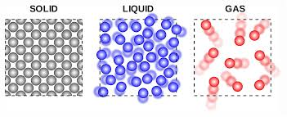
Concept Development
CFU 1
What are the 2 factors that affect the speed of sound?
Factors that affect the speed of sound:
How close the particles are together
Particles that are closer together can transmit energy to nearby particles faster.
The temperature of the medium
Particles at higher temperatures have higher kinetic energy
Since they are already vibrating fast, the wave moves more easily.
CFU 2
True or false: Sound travels faster in a more dense medium, than a less dense medium?
CFU 3
Would the speed of sound in air be faster in winter or summer? Justify your answer.
Vocabulary
Density: mass per unit of volume.

Slide 8
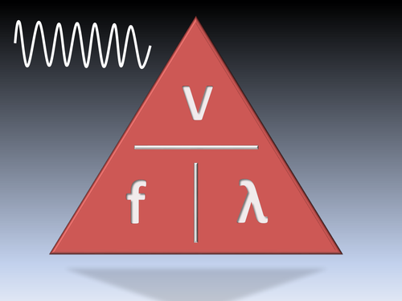
Concept Development
CFU 1
What is the unit of measurement for wave speed (velocity)?
Wave Speed
The speed of a wave speed is related to both its wavelength and its frequency:
Wave speed = wavelength x frequency
v = f x λ
Where:
v= velocity (speed), measured in m/s
λ= wavelength, measured in m
f= frequency, measured in Hz
CFU 2
What does the frequency tells us about a wave?
CFU 3
What equation would you use to calculate the wavelength if you are given the wave speed and frequency?
Reminder
Frequency – waves per second, measured in Hertz Wavelength – distance between two peaks or two troughs

Slide 9
Skill Development / Guided Practice
Calculating Values Relating to Sound Waves
Write down the information you are given and what you are trying to find. Rearrange the equation to find your unknown. Put your numbers into the equation and solve. Add appropriate units.
A sound wave travelling through an unknown medium has a frequency of 50Hz and a wavelength of 10m. What is the speed of the wave?
1. f = 50 Hz
λ = 10 m
v = ?
2. v = f x λ
3. v = 50 x 10
v = 500
Reminder of Units
Frequency – Hz Wavelength – m Wave speed – m/s
4. The speed of the sound wave is 500 m/s.

Slide 10
Skill Development / Guided Practice
Calculating Values Relating to Sound Waves
Write down the information you are given and what you are trying to find. Rearrange the equation to find your unknown. Put your numbers into the equation and solve. Add appropriate units.
A sound wave is travelling through an unknown medium and has a wave speed of 70 m/s. What is the frequency of the wave if the wavelength of the wave is 2 metres?
1. f = ?
λ = 2 m
v = 70 m/s
2. f = v
λ
3. f = 70
2
f = 35
Reminder of Units
Frequency – Hz Wavelength – m Wave speed – m/s
4. The frequency of the sound wave is _____ .

Slide 11
Skill Development / Guided Practice
Calculating Values Relating to Sound Waves
Write down the information you are given and what you are trying to find. Rearrange the equation to find your unknown. Put your numbers into the equation and solve. Add appropriate units.
A sound wave travelling through an unknown medium has a frequency of 15 Hz and a wavelength of 3 metres. At what speed will this wave travel?
1. f = _____
λ = _____
v = _____
2. v = f x λ
3. v = __ x __
v = __
Reminder of Units
Frequency – Hz Wavelength – m Wave speed – m/s
4. The speed of the sound wave is _____ .

Slide 12
Skill Development / Guided Practice
Calculating Values Relating to Sound Waves
Write down the information you are given and what you are trying to find. Rearrange the equation to find your unknown. Put your numbers into the equation and solve. Add appropriate units.
A sound wave travelling through air at a velocity of 340 m/s has a frequency of 680 Hz. What is the wavelength of this wave?
1. f = _____
λ = _____
v = _____
2. λ = _____
3. λ = __ /__
λ = ____
Reminder of Units
Frequency – Hz Wavelength – m Wave speed – m/s
4. The wavelength of the sound wave is _____ .

Slide 13
Skill Development / Guided Practice
Calculating Values Relating to Sound Waves
Write down the information you are given and what you are trying to find. Rearrange the equation to find your unknown. Put your numbers into the equation and solve. Add appropriate units.
A sound wave travelling through an unknown medium is traveling at 230m/s has a wavelength of 2.1 metres. What is the frequency of this wave?
1. f = _____
λ = _____
v = _____
2. f = _____
3. f = __ /__
f = ____
Reminder of Units
Frequency – Hz Wavelength – m Wave speed – m/s
4. The frequency of the sound wave is _____ .

Slide 14
Relevance
Understanding the speed of sound in air will help you explain many sound related phenomena. E.g. thunder, sound delays.
Some animals use the speed of sound to hunt their prey.
Technology such as SONAR, echo sounders, RADAR use the speed of a wave to make observations.

Slide 15
Skill Closure
Medium | Sound Speed (m/s)
Air (0°C) | 331 m/s
Air (20°C) | 343 m/s
Water (20°C) | 1482 m/s
Lead | 1960 m/s
Glass | 5640 m/s
Steel | 5960 m/s
How does the speed of sound depend on the temperature of the medium through which it is travelling? Explain why this happens.
Skill Closure
How does the speed of sound depend on the temperature of the medium through which it is travelling? Explain why this happens.
Skill Closure
A wave has a wavelength of 0.5metres and a frequency of 120Hz. What is the wave’s speed?
Calculating Values Relating to Sound Waves
Write down the information you are given and what you are trying to find. Rearrange the equation to find your unknown. Put your numbers into the equation and solve. Add appropriate units.

Slide 16
Independent Practice
Complete the worksheet on Speed of Sound Calculations.
Any early finishers are to commence work on the Speed of Sound theory worksheet.

